Slide 1
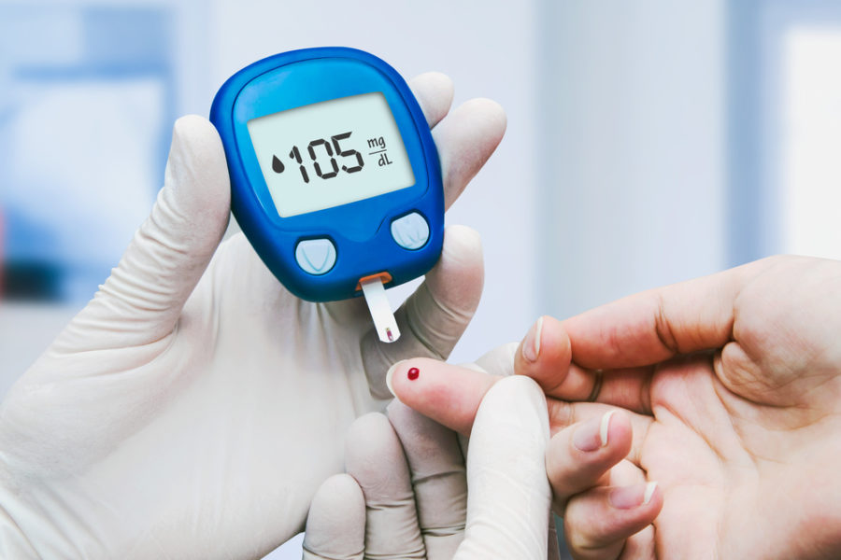
Empowering Prevention: Your Personalized Diabetes Risk Forecast
Presented by Diego Rodriguez
CAPSTONE PROJECT COHORT 2024-02-26-ds-pt-nz
Institute of Data – AUT 2024-08-10

Slide 2
Agenda
Introduction
Industry/Stakeholders
Business and Data Questions
Dataset Information
Data Science Process (EDA, Key Findings, Modeling, Best Model and Metrics)
Data and Business Answers
Future Work
Q&A

Slide 3
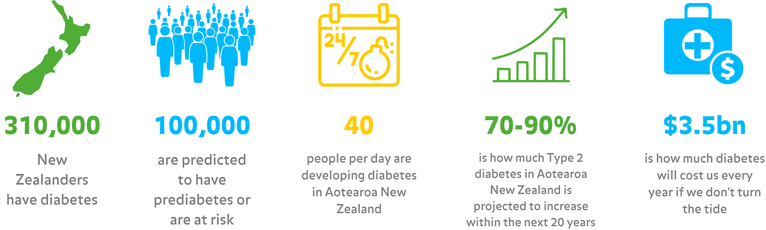
Introduction
What is diabetes?
Why does diabetes matters?
Prevention vs Treating?
Machine Learning and AI.

Slide 4




Industry / Stakeholders
Healthcare industry.
Healthcare providers.
Public health officials.
Patients.

Slide 5
“Prevention is better than cure.”
— Desiderius Erasmus (1500)

Slide 6
Business & Data questions
How can healthcare providers identify individuals at high risk of developing diabetes, allowing for early intervention and better management of healthcare resources?
Can we use historical health indicators to predict the likelihood of an individual developing diabetes?

Slide 7
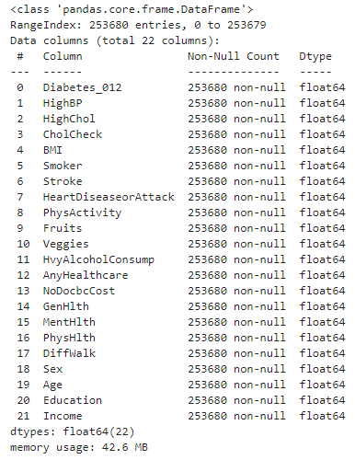
Dataset Information
Diabetes Health Indicators Dataset.
253.680 survey responses.
- 21 Features.
- Target variable: Diabetes_012
- Independent variables: Features include age, BMI, physical activity, smoking status, and other health metrics.
Location: https://www.kaggle.com/datasets/alexteboul/diabetes-health-indicators-dataset

Slide 8
Data Science Process
Goal
Expectations
Collection & Preprocessing
EDA
Feature Engineering
Model Development
Hyperparameter tuning
Final evaluation
- Business and Data answers
Business Problem
Data Process
Model Selection
Outcome

Slide 9
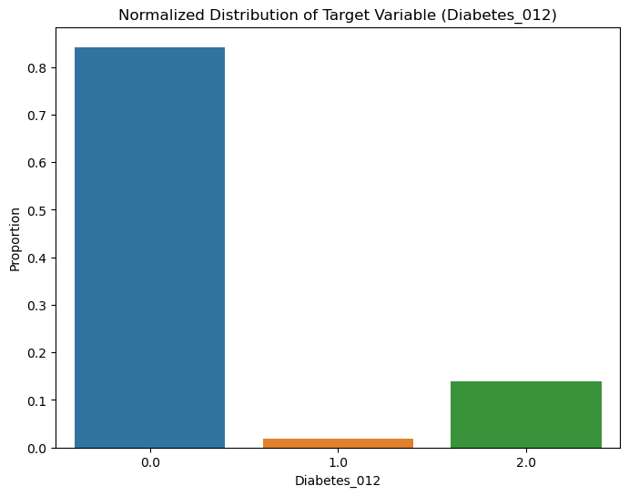
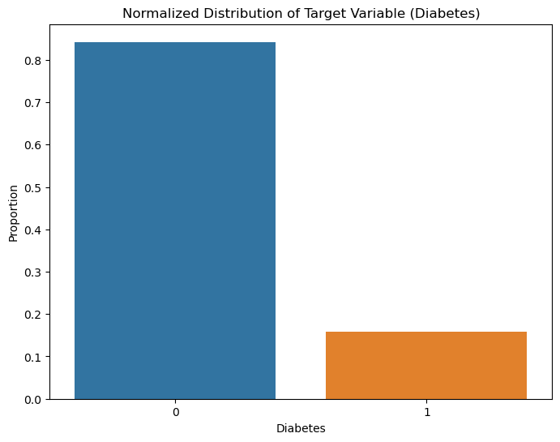
Findings
Target Variable.

Slide 10
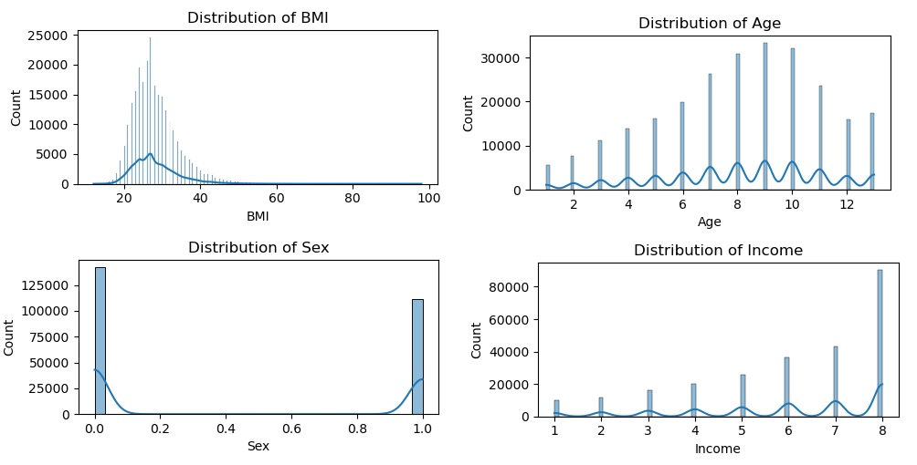
Findings
BMI, Age, Sex, Income.

Slide 11
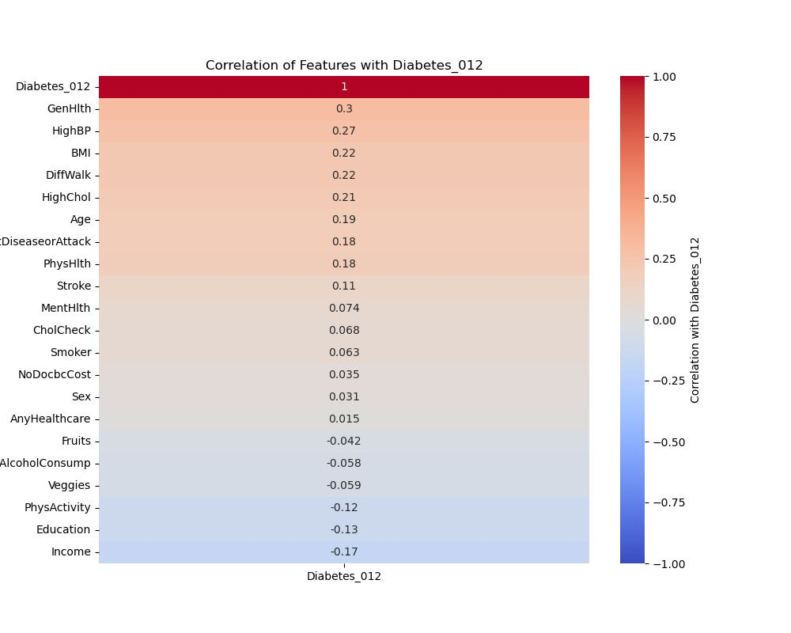
Findings
Correlations.

Slide 12

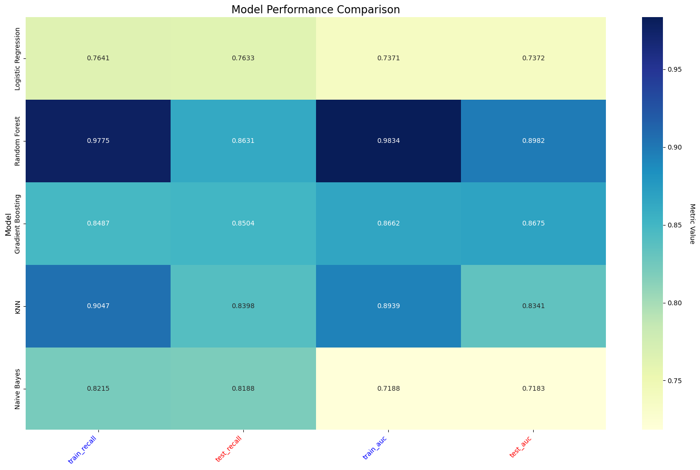
Modelling
Classification Models & Metrics

Slide 13
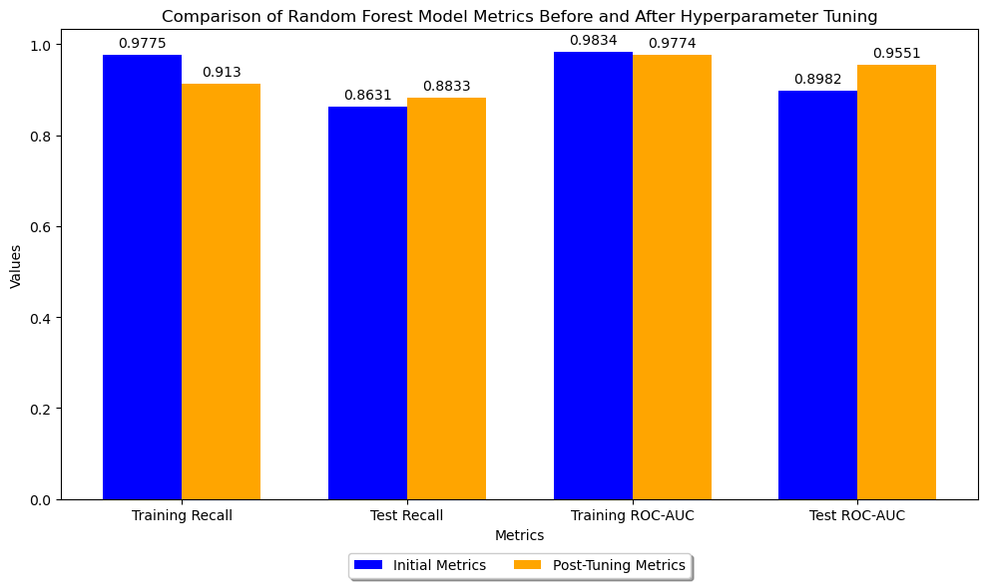
Hyperparameter tuning

Slide 14
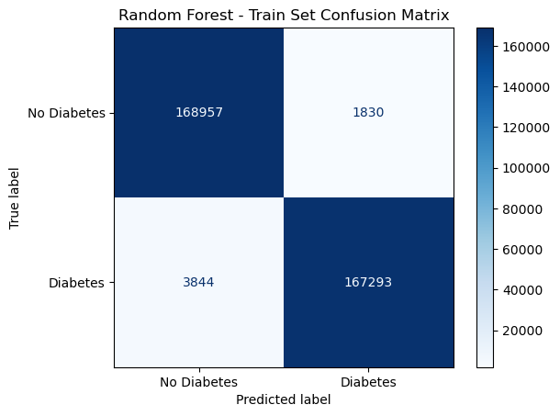
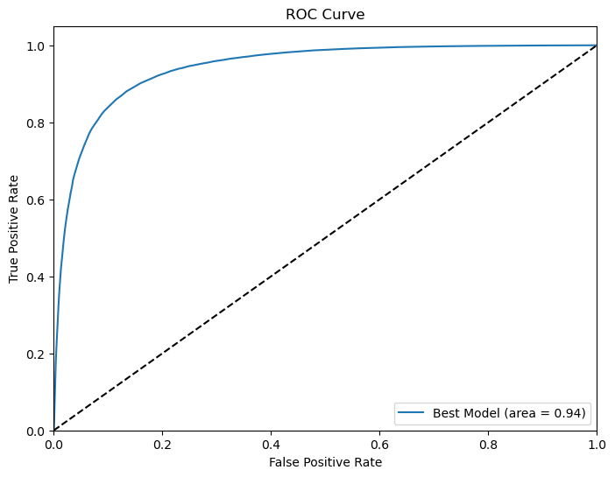
Business and Data Answers
Random Forest Model (Time and performance).
Effectively capture true positive cases.
Good learning patterns from data.
Generalizes well to new and unseen data.
Utility of ML models in the real-world healthcare predicting diabetes risk.
Reliable tool within the industry.
Helps to identify individuals at risk.
test recall of 88.33% and a test ROC-AUC of 95.51%

Slide 15

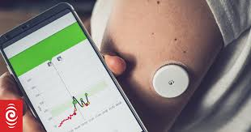
Future work
Integrating additional data sources
Deploying the model as part of a patient-facing tool
Continuously update and refine the model.
Preventive healthcare strategy

Slide 16
THANKS!
Questions ?
diego_frg@hotmail.com
+64 212174394

